Slide 1
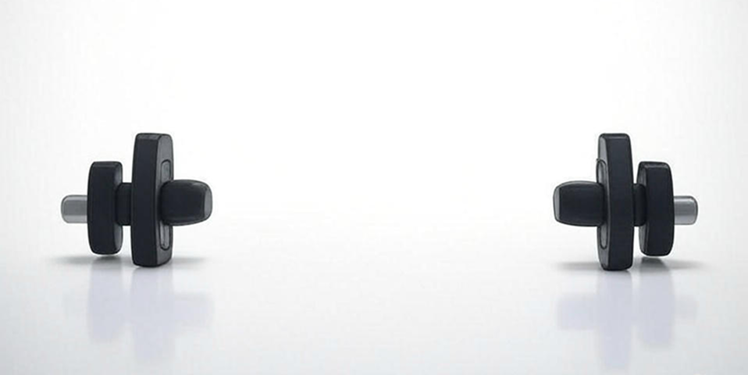
FitMind

Slide 2
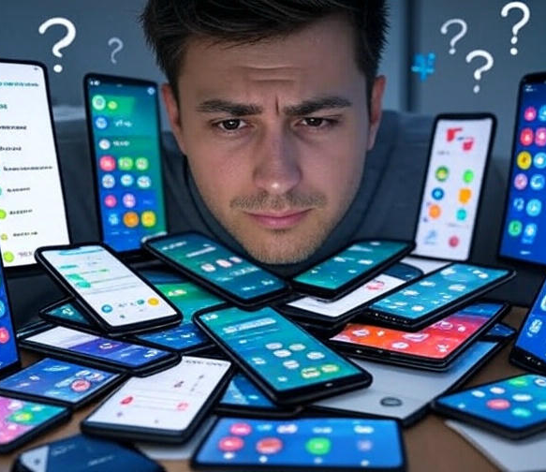
Why should I care?
Notion
MyFitnessPal
Google Calendar
Strava

Slide 3
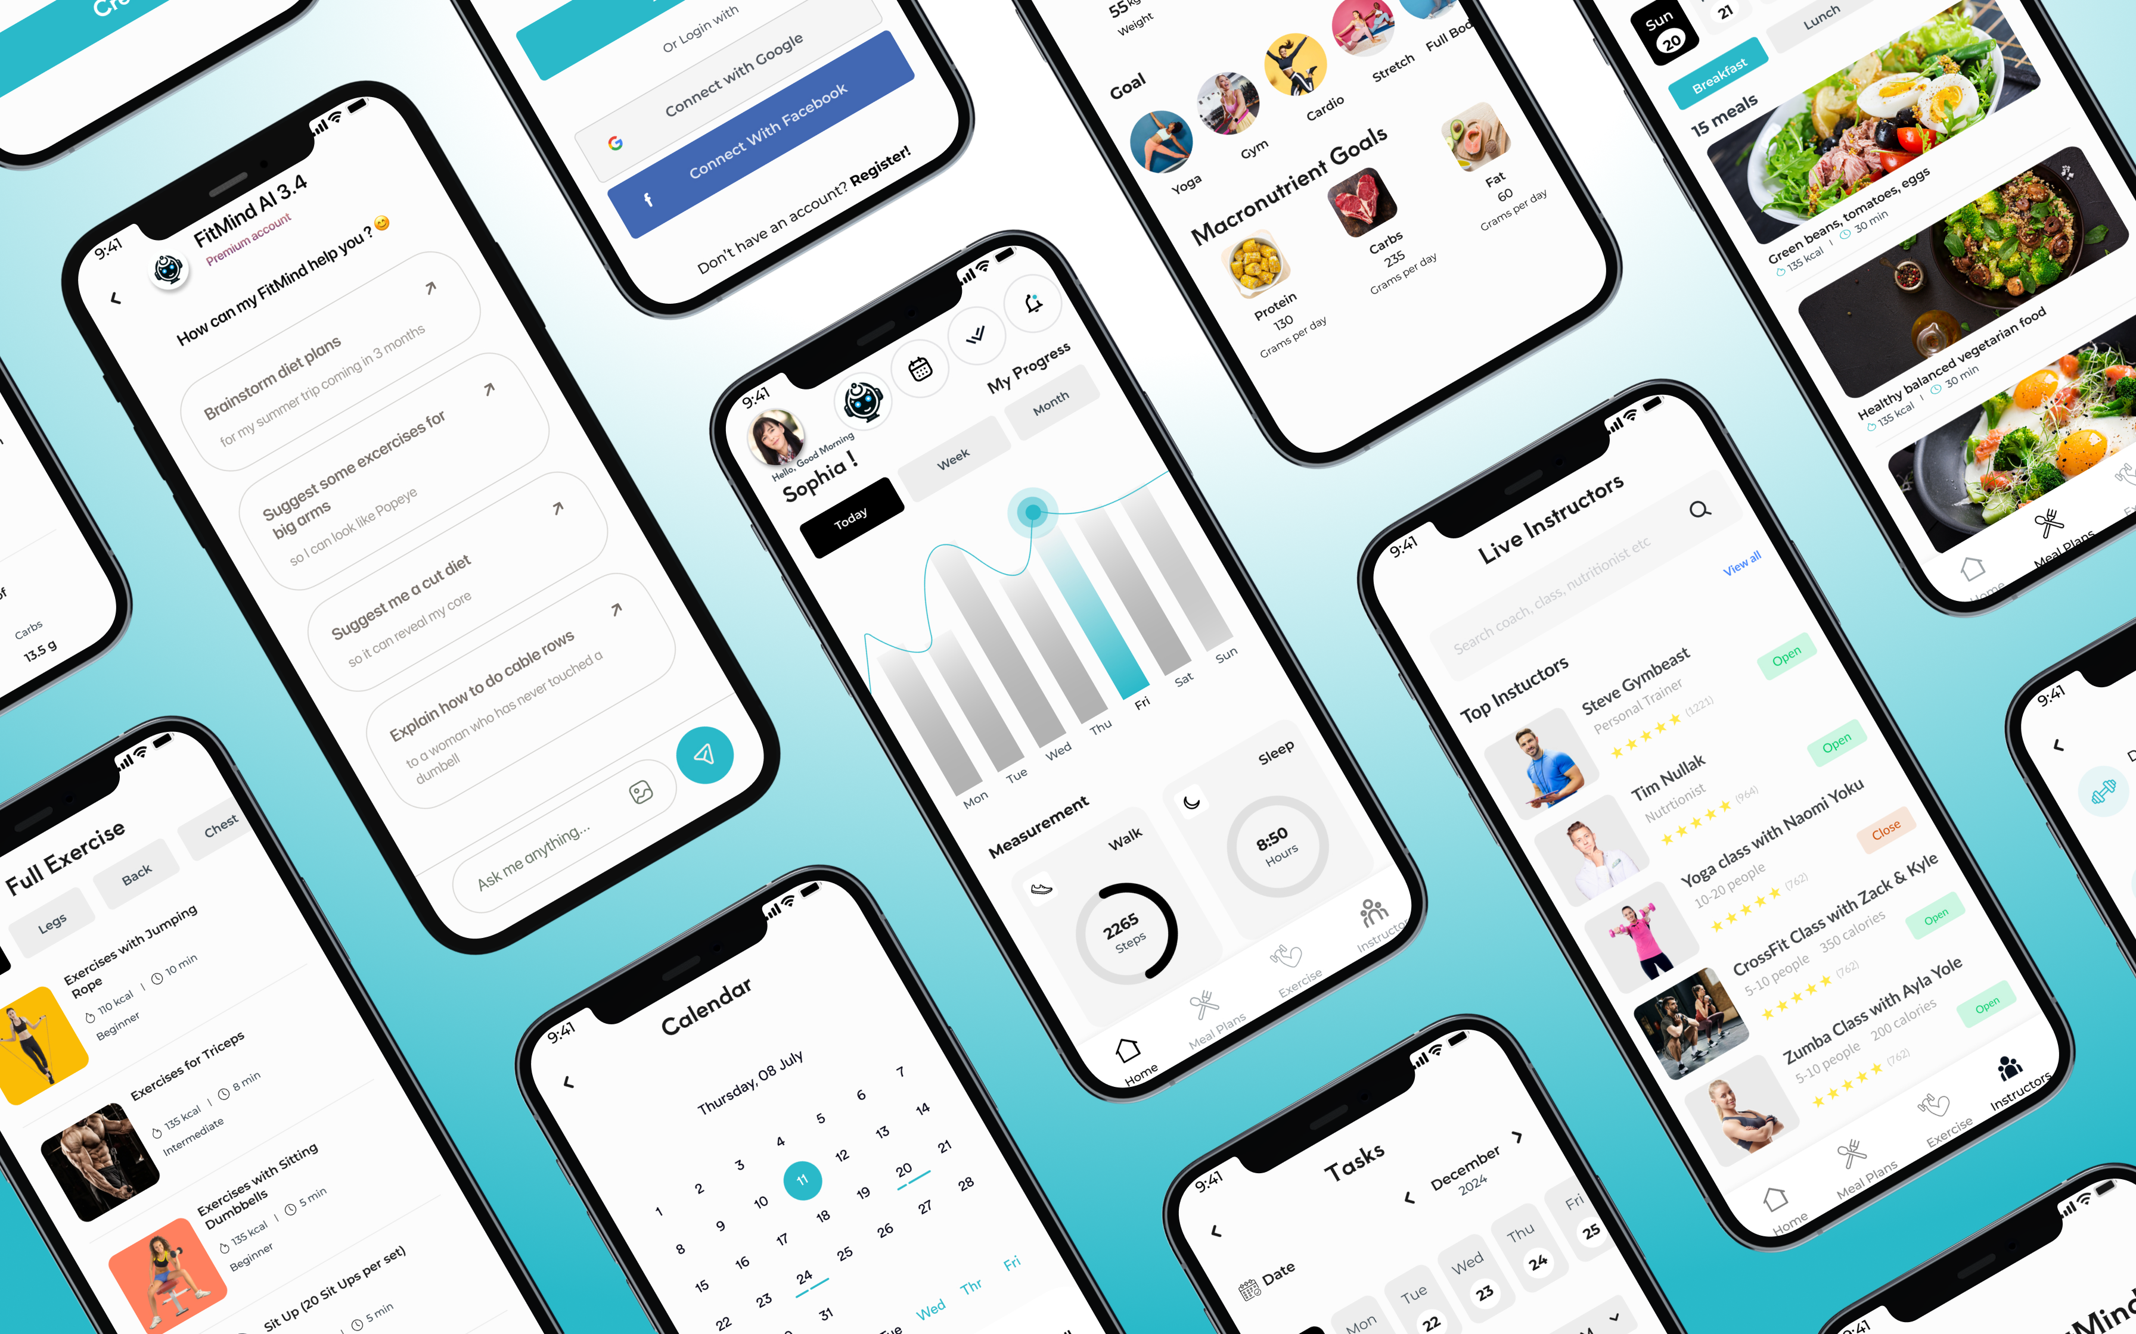

Slide 4
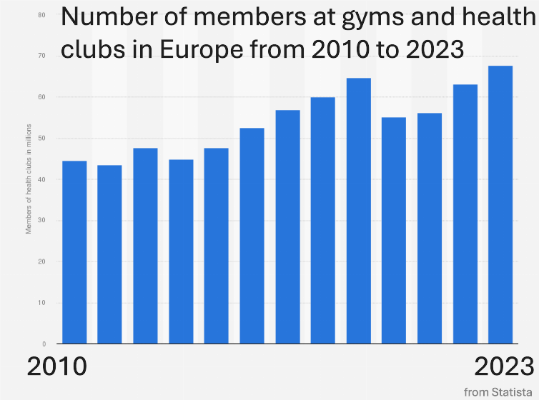
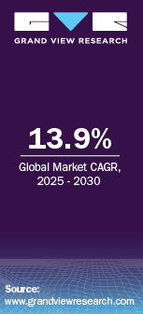
Fitness App Market Size

Slide 5
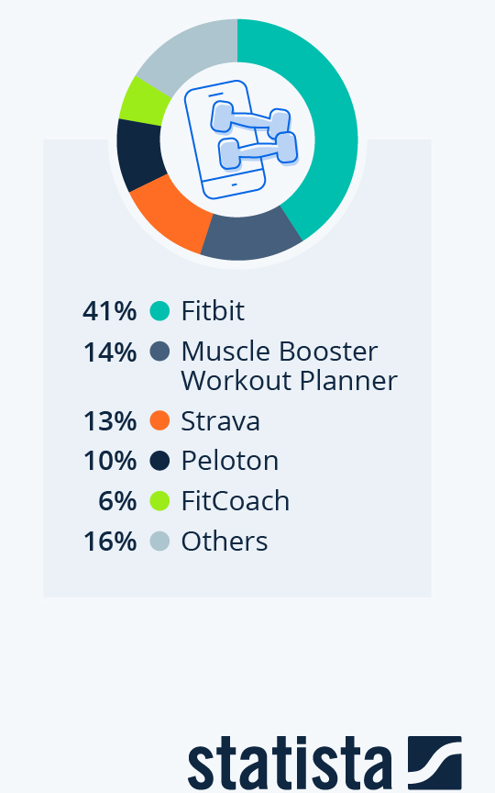



Fitness App Market Share
Competition/Functionality | Fitbit | Muscle Booster | Strava | FitMind
Ασκήσεις
AI Chatbot
Live Instructors
Οργάνωση

Slide 6










FitMind Business Model Kit
Small Gym/Nutrition Catalog
Small Gym/Nutrition experience
Free User
Gym/Nutrition Support
Gym/Nutrition Catalog
exposure
exposure
data
FitMind
Premium Gym/Nutrition experience
Premium Gym/Nutrition Catalog
exposure
Royalty Fees
Analytics
Professionals
exposure
money
Analytics
Pay Per Click
money
Premium User
exposure
data
Advertiser

Slide 7

ΣΤΟΧΟΙ ΕΞΑΜΗΝΟΥ

Slide 8

Η ΟΜΑΔΑ ΜΑΣ

Slide 9
